Slide 1

DriverPass System Analysis
[Your Name]
Notes:
[No speaker notes required for this slide.]

Slide 2

System Requirements
Functional Requirements
Validation of users upon log-in
Tracking user progress in a dashboard
Non-Functional Requirements
Server-hosted, web delivered
Support fast video streaming
Notes:
Some of the DriverPass functional requirements, the things that the application will be expected to do, are first and foremost validate user logins. This will be essential to maintaining a secure and private environment, especially since most users are expected to be minors or parents of minors. The user dashboard will display sensitive information about the user’s progress, as well as personal information. Validation will help to ensure that each user sees only their own dashboard and thus only their own personal information. How will users access the DriverPass application? Via the web, specifically their individual web browsers. This means the application will be hosted on a server, preferably at a third party so that DriverPass does not have to worry about maintenance. This server host will need to also support fast delivery of content, since one of the features of DriverPass is streaming of driver-instruction related videos. With the videos being potentially accessed by multiple parties at once, they will need to be hosted on a platform that can keep up with the demand, especially during peak hours of the day (likely to be between 1pm and 4pm, after school hours).

Slide 3
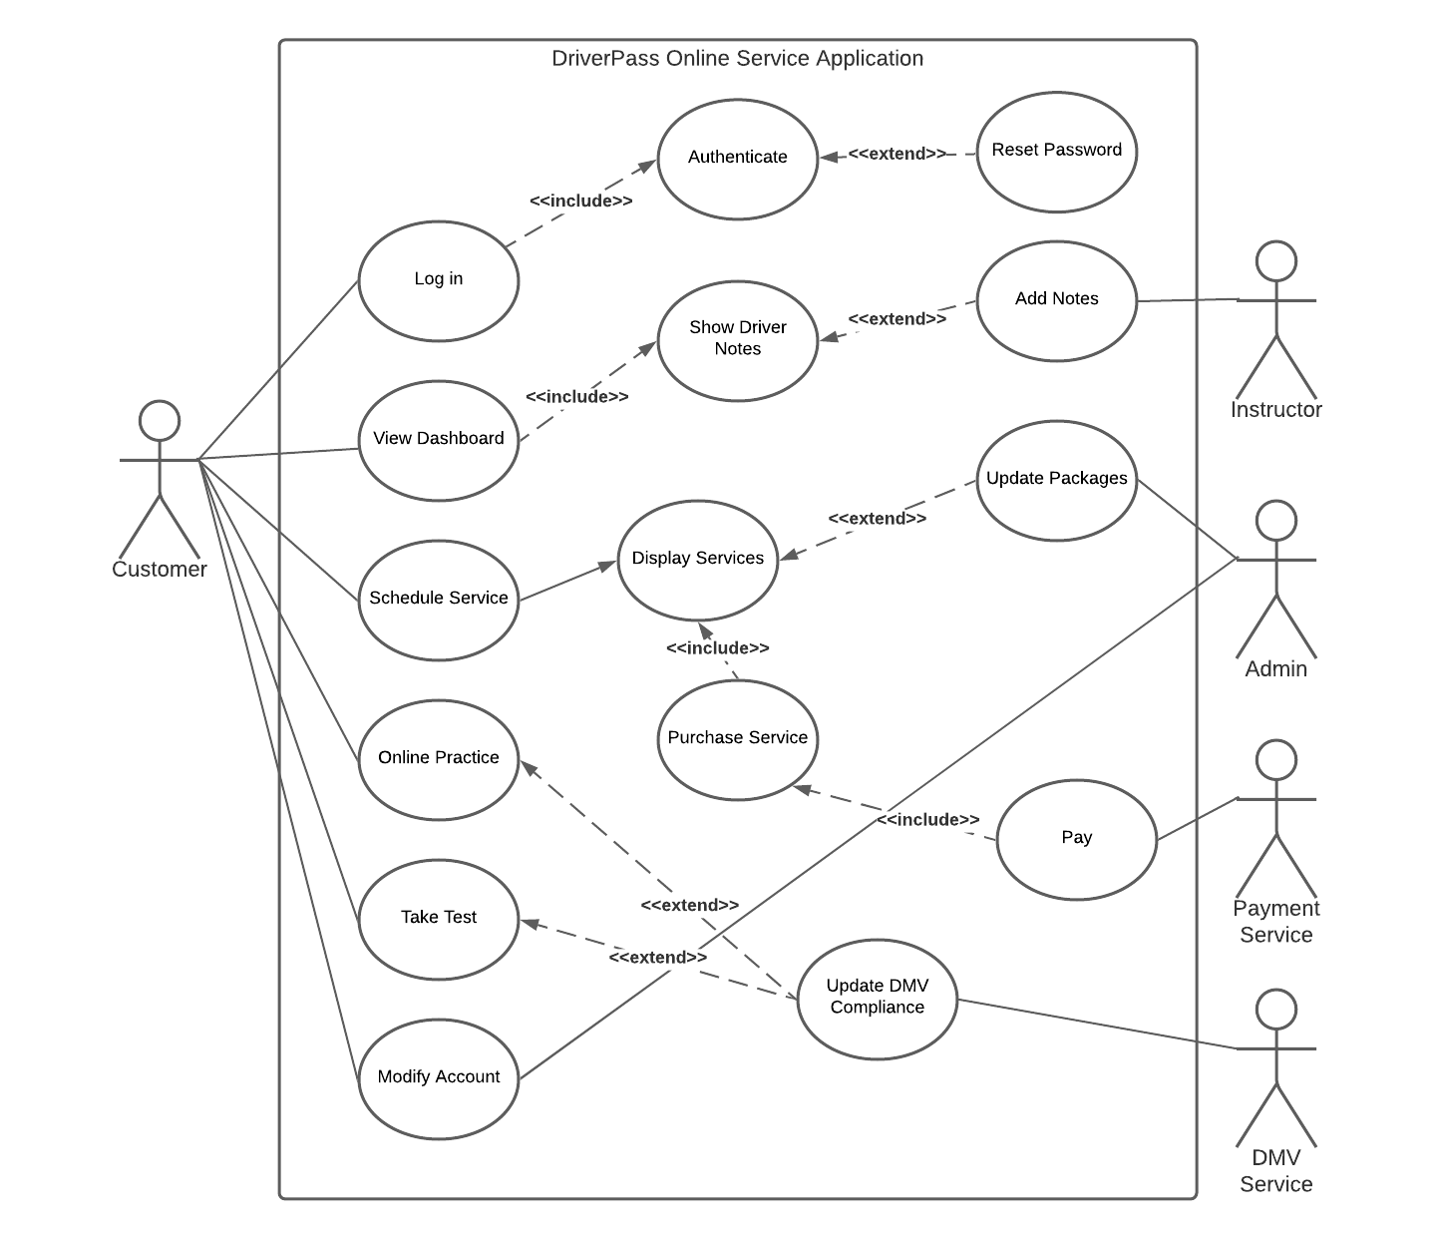
Use Case Diagram
Notes:
The DriverPass application is expected to perform a multitude of tasks, as shown here in this diagram. Once a user logs in to the app they will be met with a dashboard that allows them to select a number of items, including the option to take practice tests, schedule driver training, or watch online practice videos. The content designed to help drivers learn what they need in order to pass the tests at the DMV will be updated by the DMV itself through a special connection service. The services offered by DriverPass (currently, the three different tiers of testing) can be updated by administration on a need-to basis. When the dashboard is displayed to users, any notes that their driving instructor has submitted will be displayed here. However, for new users, no notes will show yet. Administrators and users will have the ability to modify user accounts, as administrators are expected to also be able to help users purchase services via phone.

Slide 4
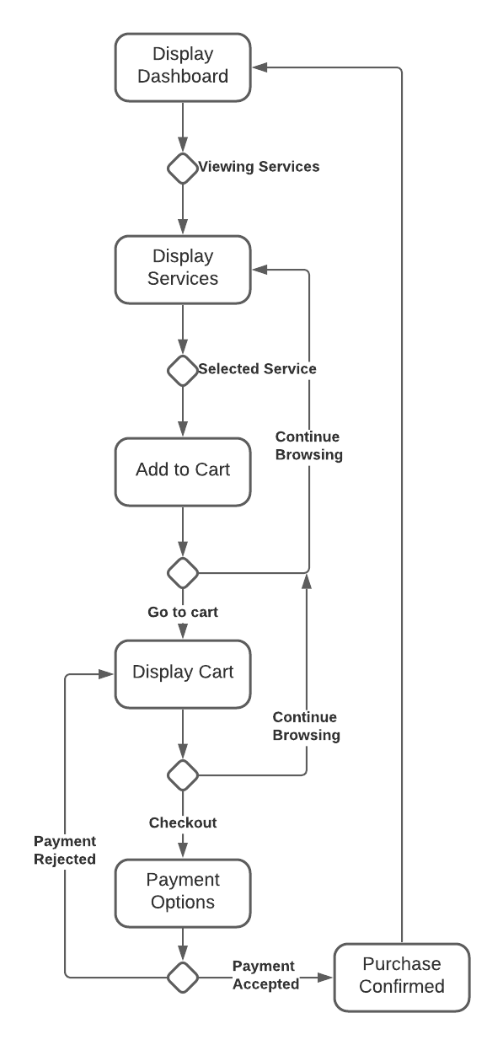
Activity Diagram
Notes:
Here we see a sample of what a customer of DriverPass may do while on the application. Starting at the user dashboard, this user decides to view the services (driver instruction) that DriverPass offers. The system will display the service available in an easy to understand viewport. Should the customer choose to select a service for purchase, it will be added to an online shopping cart for purchase later. At this point, the customer can continue browsing services, or move forward with the purchase by selecting to display the cart. From within the shopping cart, the user may again go back and continue browsing, or proceed to checkout, where they will be given the opportunity to either 1: use a previously saved payment option, or 2: enter new payment information. The payment is then processed by a third party, and if the payment is accepted/verified, the customer will see a “confirmation” message (and receive an emailed receipt), and then be returned to the user dashboard. If the payment is rejected by the payment service, the user is returned to their cart to start the checkout process over again, or return to browsing.

Slide 5
Security
In order to maintain security, the following will be put in place within the system
Unique user ID’s
10+ minimum character password
Upper/lower letters, numbers, symbols
Optional two-factor authentication
Maximum attempts to log-in capped
Utilize HTTPS over TLS for all data
Encrypted user information on server / database
Notes:
Since sensitive user information will be found on the DriverPass application, it is important to consider security when designing certain parts of the app. When logging in for the first time, users will be prompted to create a user ID that must be unique from all other users’ ID’s. This will be check as they create the ID. Aftwards, users will be required to create a password that meets minimum requirements such as a minimum length of 10 characters, using at least one uppercase and lowercase letter, a number, and a special symbol. Their username will not be allowed within their password, and easy passwords (password, qwerty, etc) will not be allowed. Users can turn on two-factor authentication if they wish. If a user attempts to log-in more than a set number of times, their account will be locked automatically and they will be directed to contact admin in order to re-access and reset their password. User data that is store on the server will be encrypted, no plain-text passwords or payment information will be available to any potential security breaches.

Slide 6
System Limitations
Limitations of the Proposed Design
User access
Browser type
Bandwidth
Streaming
Outside system connections
Notes:
Based on the proposed design I can foresee several potential limitations of the system. The first and most important will be how users access the system. Since it is to be web-based, users will need an internet connection and web-browser to view DriverPass content. Their individual connections speeds may or may not be reliable enough to deliver content fast enough (say, for streaming informational videos). Likewise different internet browsers exist, and the DriverPass cannot be made to work on every single one every invented! Therefore, the application should be developed with the top browsers in mind (Chrome, Safari, and Edge/IE). The streaming of web content on DriverPass will be another issue, since all files will be hosted in the same place. While many users are accessing content at once, streaming may become bogged down. This will require a hosting company with a reliable connection that is also fast and supports multiple connections. Finally, the application relies heavily on outside services (such as the DMV updating compliancies) and if these services go down, how will that affect the application? It will be important to design the app to be able to still function even when these services are unavailable. Users will still need to be able to browse services available, and view their dashboard or practice tests. If payment services go down, users can still place items in their cart for purchase later. Services available to customers may have an “updated last: xx/xx/xx” tag to show users how recent a DMV compliance update took place.

